Slide 1
Microsoft Dynamics AX 2012 Administration Workshop Chapter 6: General System Administration
Presenter Name
Presenter Title
Presenter Company

Slide 2
Conditions and Terms of Use
Microsoft Confidential
This training package is proprietary and confidential, and is intended only for uses described in the training materials. Content and software is provided to you under a Non-Disclosure Agreement and cannot be distributed. Copying or disclosing all or any portion of the content and/or software included in such packages is strictly prohibited.
The contents of this package are for informational and training purposes only and are provided "as is" without warranty of any kind, whether express or implied, including but not limited to the implied warranties of merchantability, fitness for a particular purpose, and non-infringement.
Training package content, including URLs and other Internet Web site references, is subject to change without notice. Because Microsoft must respond to changing market conditions, the content should not be interpreted to be a commitment on the part of Microsoft, and Microsoft cannot guarantee the accuracy of any information presented after the date of publication. Unless otherwise noted, the companies, organizations, products, domain names, e-mail addresses, logos, people, places, and events depicted herein are fictitious, and no association with any real company, organization, product, domain name, e-mail address, logo, person, place, or event is intended or should be inferred.
Copyright and Trademarks
© 2013 Microsoft Corporation. All rights reserved.
Microsoft may have patents, patent applications, trademarks, copyrights, or other intellectual property rights covering subject matter in this document. Except as expressly provided in written license agreement from Microsoft, the furnishing of this document does not give you any license to these patents, trademarks, copyrights, or other intellectual property.
Complying with all applicable copyright laws is the responsibility of the user. Without limiting the rights under copyright, no part of this document may be reproduced, stored in or introduced into a retrieval system, or transmitted in any form or by any means (electronic, mechanical, photocopying, recording, or otherwise), or for any purpose, without the express written permission of Microsoft Corporation.
For more information, see Use of Microsoft Copyrighted Content at http://www.microsoft.com/about/legal/permissions/
Microsoft®, Bing®, Microsoft Dynamics®, SQL Server®, and Windows® are either registered trademarks or trademarks of Microsoft Corporation in the United States and/or other countries. Other Microsoft products mentioned herein may be either registered trademarks or trademarks of Microsoft Corporation in the United States and/or other countries. All other trademarks are property of their respective owners.

Slide 3
Students: How to View this Presentation
Switch to Notes Page view
Click View on the ribbon and select Notes Page
Use page up or page down to navigate
Zoom in or out as needed
Most slides will have supporting text that you can view now or after the delivery
Add notes to your copy of the presentation if you want to
You take the presentation files home with you.

Slide 4
Objective
Review general system setup and parameters
Review number sequence options
Review user sessions and options
Review table and index options

Slide 5
Introduction
There are several tasks that must be completed and set up in the System administration module that control the basic configuration of the system.
Some settings are optional, but the system implementer should review each of the following to decide if further set up is required for your business:
AOS maintenance
Select options for client performance
System service accounts
License file and configuration
System configuration and parameters
Notes:
There are several tasks that must be completed and set up in the System administration module that control the basic configuration of the system. Some of these settings are optional, but the systems implementer should review each of the following to decide if further set up is required for your business:
AOS maintenance.
Select options for client performance.
Specify or update system service accounts for the business connector, workflow, Project Server Synchronization, and the Bing Map account.
Load a license file or view existing license information.
Work with the system configuration.
Set up basic system parameters.
The following topics discuss, in detail, how to work with and update each of the configurations.

Slide 6
AOS Maintenance - Draining Users
User Notice
After 5 minutes, all users receive a message informing them that they must save their work because the administrator is shutting down the AOS instance.
No New Client
No new client connections are accepted during this time.
Connections Closed
The server forces client sessions to close after they have been idle for 2 minutes.
Admin Sessions Not Affected
Client sessions for administrators are never closed. When the number of clients connected to the AOS instance is displayed as 0 (zero), you can perform maintenance on the server.
Notes:
Important: The following procedure requires that you click the Reject new clients button in Microsoft Dynamics AX. After you click this button, you must not close your client. If you close your client before you click the Accept new clients button, you cannot open a new client session unless you restart the AOS instance by using the Windows Services Management console, or unless you reset the SysServerSessions table in SQL Server to a value of 1.

Slide 7
Drain Users from an AOS
Scenario: You must perform maintenance on an AOS and need to take it offline without affecting users.
Procedure: System administration > Common > Users > Online users.
Notes:
There may be times when you have to perform maintenance on an AOS and need to take it offline. This section discusses how to close client sessions that are connected to an instance of Application Object Server (AOS) for Microsoft Dynamics AX. When you close client sessions without force, you are said to drain users.
Scenario: Drain users from an AOS
Gary, the Systems Implementer, must perform maintenance on one of his AOS’s and wishes to take it offline without taking all AOS’s offline.
Procedure: Drain users from an AOS
In this procedure, you will drain users from an AOS.
Click System administration > Common > Users > Online users.
On the Server instances tab, select the AOS instance that you want to perform maintenance on.
Click Reject new clients. The screenshot on the slide above shows Reject new clients.
When you are prompted, click OK to stop the AOS instance from accepting new client connections.
Important: The following procedure requires that you click the Reject new clients button in Microsoft Dynamics AX. After you click this button, you must not close your client. If you close your client before you click the Accept new clients button, you cannot open a new client session unless you restart the AOS instance by using the Windows Services Management console, or unless you reset the SysServerSessions table in SQL Server to a value of 1.

Slide 8
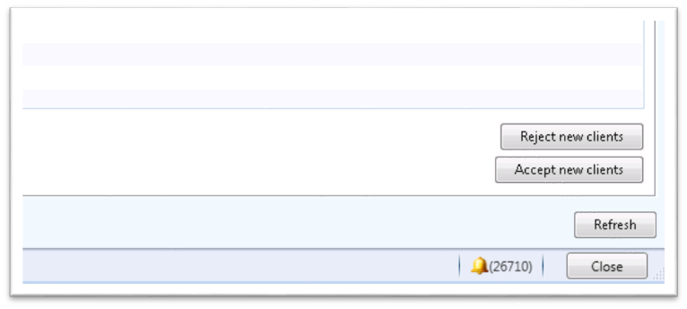
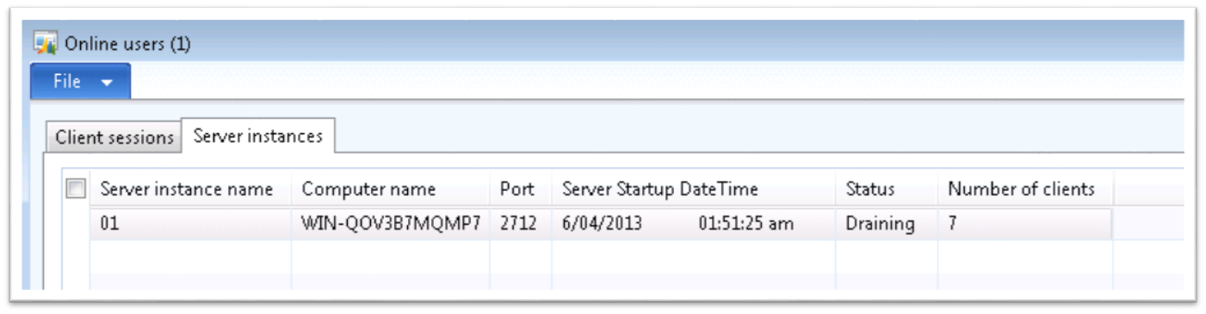

Drain Users from an AOS
System administration > Common > Users > Online users > Reject new clients
Note the status is now set to Draining

Slide 9
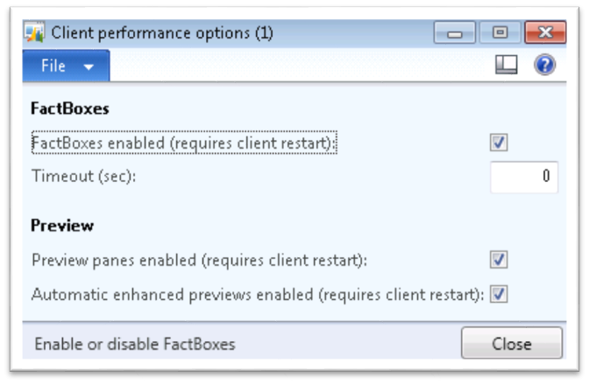
Manage Client Performance Options
System administration > Setup > System > Client Performance Option
FactBoxes enabled
Preview panes enabled
Automatic enhanced previews enabled
Notes:
There are three client performance options that the administrator can enable or disable system-wide to help improve system performance.
The screenshot on the slide above shows the Client Performance Options form.
FactBoxes enabled (requires client restart): Select this option to display FactBoxes on all forms and list pages by default. If this option is disabled, FactBoxes will not display in the client.
Preview panes enabled (requires client restart): Select this option to display preview panes on list pages by default. If this option is disabled, preview panes will not display in the client.
Automatic enhanced previews enabled (requires client restart): Select this option to display enhanced previews on all forms and list pages by default. If this option is disabled, enhanced previews will not display in the client.

Slide 10
Manage System Service Accounts
System administration > Setup > System > System Service Account
Business Connector proxy account
Workflow execution account
Synchronization service account
Bing Maps account
Notes:
Use the System service accounts form to configure the accounts used to run Microsoft Dynamics AX services. Service accounts include the Business Connector proxy account, the Workflow system account, the Workflow execution account, the synchronization service account, and the Bing Maps account.
The Business Connector proxy account is used for communication between Microsoft Dynamics AX and other applications.
The Workflow execution account is used for running application business logic and accessing Microsoft Dynamics AX data.
The Synchronization service account is used for communication between Microsoft Dynamics AX, Message Queuing, and Project Server.
The Bing Maps account is used to access the online Bing Maps when working in Enterprise Portal.

Slide 11
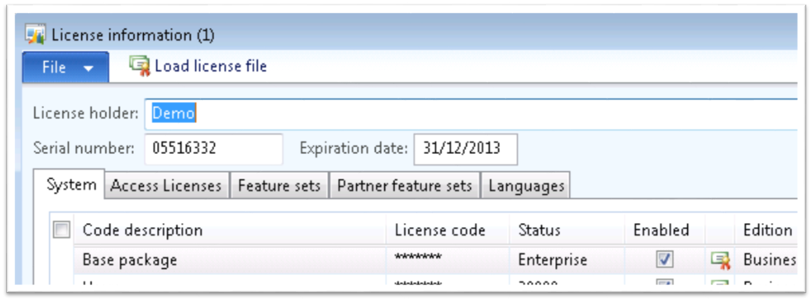
Load License Information
System administration > Setup > Licensing > License information
Notes:
To be able to use Microsoft Dynamics AX, the administrator must enter license information. By entering license codes, you enable the general functionality covered by the license. Then, you can enable or disable access to more specific features by changing configuration keys.
In addition to license codes for Microsoft Dynamics AX functionality, there are licenses for access to the Microsoft Dynamics AX development environment. If you do not have a license, you can set up Microsoft Dynamics AX in demonstration mode. Demonstration mode provides all the functionality of Microsoft Dynamics AX and enables all configuration keys, by default.
Use the License information form to enter license codes and to view the name of the license holder, the serial number for the system, and the expiration date for the system. You can also examine the Status field to see that each code is verified. The necessary information is supplied in your license document.
Note: If you change the current license settings because license keys are updated, the new functionality will not be available until the client is restarted.

Slide 12
Notes Continued
Notes:
Load License Information (continued)
Procedure: Load License Information
To load license information, follow these steps.
Open System administration > Setup > Licensing > License information. –or– Open the License information form from the initialization checklist or the upgrade checklist.
Click Load license file to import the license codes from a file.
The Load license file dialog box appears.
Click the folder icon and browse for the license file.
Click OK. A message appears, asking whether you want to synchronize the database.
Click Yes.
Close the License information window.
Security Note: It is strongly recommend that you store your license file in a secure location, known only to Microsoft Dynamics AX administrators.

Slide 13
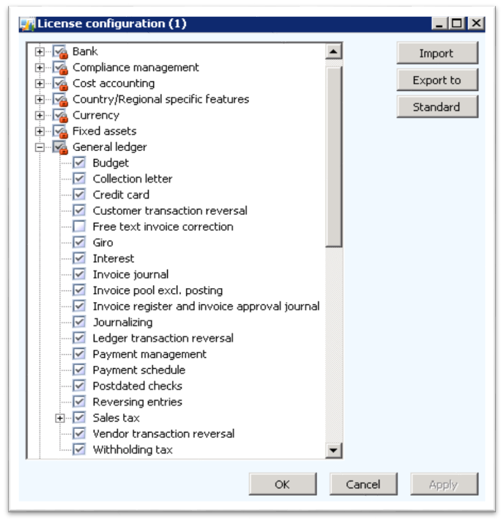
License Configuration
System administration > Setup > Licensing > License configuration
Enable/disable application features.
Disabling features may delete data related to the feature.
Disabling features will not affect DB schema as it did in previous versions.
Notes:
Procedure: Set Up Configuration Keys
Open System administration > Setup > Licensing > License configuration. –or– Open the Configuration form from the initialization checklist.
The screenshot on the slide above shows the License Configuration Form.
The form displays a list of the configuration keys that you can use to enable features. Some configuration keys have a parent key. If the parent key is disabled, the child keys are also disabled. With licensed installations and demonstration mode, only parent configuration keys are active; whereas, with partner licenses, all configuration keys are active.
To enable a configuration key, select the check box next to the relevant feature. Configuration keys controlled by license codes are indicated by a red padlock symbol. These keys control basic functionality and cannot be disabled. However, child keys of license code-controlled keys can be disabled.
Click Standard to discard your changes and revert configuration keys to their original state.
Click OK to save changes and close the form.

Slide 14
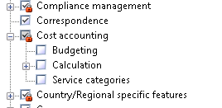
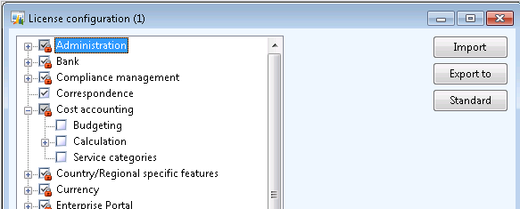
License Configuration
A red padlock indicates configuration keys controlled by license codes and cannot be disabled.
Click the Standard button to revert to their original state.

Slide 15
Manage General System Parameters
There are several general system parameters that must be defined before the system can be used
System administration > Setup > System parameters > General
System language
Increment
System currency
System exchange-rate type
Chart of account delimiter
Notes:
There are several general system parameters that must be defined before the system can be used. To define system parameters, follow these steps:
Open System administration > Setup > System parameters.
Click the General tab, and then select an option for the following fields:
System language: Enter the default language that is used by the application for text translations.
Increment: Enter the increment to use when new line numbers are assigned to the purchase order lines. The increment is a default for all purchase order lines and other order lines, such as sales and production order lines in Microsoft Dynamics AX 2012.
System currency: Select the currency to use. You can define a default currency for each ledger that you set up in the Ledger form. This currency is only used for specific cross-company totaling.
System exchange rate: Select the exchange rate to use. Define a default exchange rate type for each legal entity in the Ledger form.
Chart of accounts delimiter: Select the symbol to use as the separator between financial dimensions.
Click the Number sequences tab and then select the number sequence ID to be used for each number sequence reference.

Slide 16
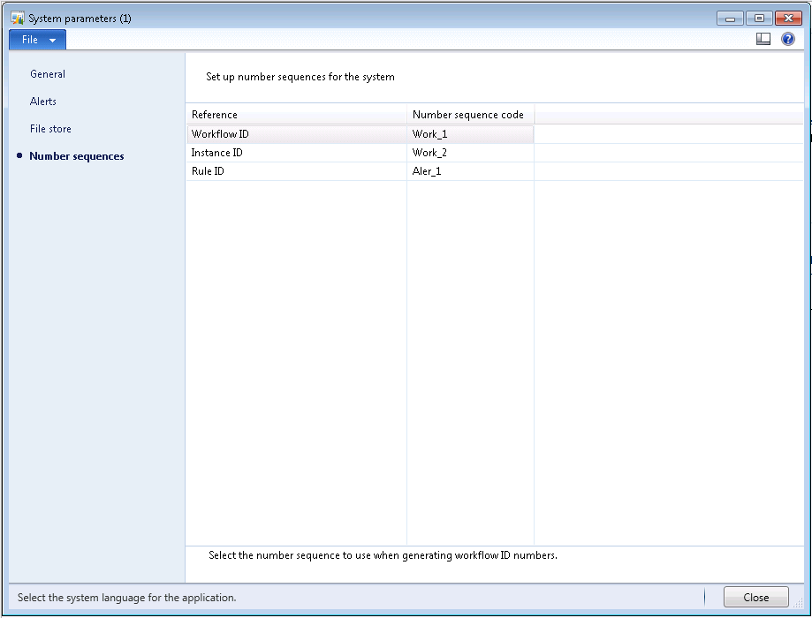
Manage General System Parameters
System administration > Setup > System parameters > Number sequences

Slide 17
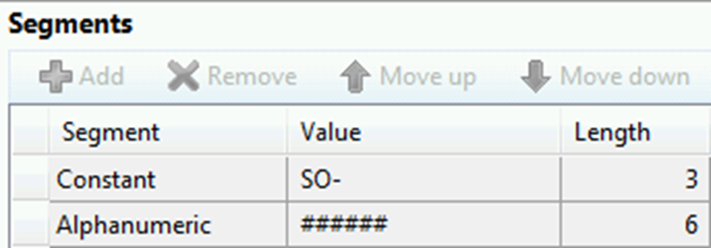
Number Sequences
Defines format and numbering scheme for records in the system. Take sales orders, for example.
Configuration can impact performance.
Continuous number sequences
Non-continuous number sequences with pre-allocation
Notes:
How your number sequences are configured can have an impact on performance, so you should have a good understanding of the various ways to configure.
The screenshot on the slide above shows the Number Sequences Form.
Continuous Number Sequences
Forcing continuous number sequences should only be done when business requirements make it necessary, because continuous numbering requires a database hit each time a number is requested and pessimistic concurrency must always be used on that table to ensure continuous numbering.
Non-Continuous Number Sequences with Pre-allocation
If continuous numbers are not a requirement, then you can set the system up so that each AOS takes a “block” of numbers and issues them. For processes with a high transaction volume, this increases performance because the system no longer requests one from the database each time, but instead works within that block until used up.
Best Practice: This is most critical to review for the processes with the highest transaction volumes.

Slide 18
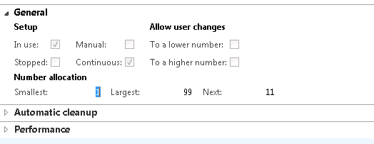
Continuous Number Sequences
Setup
Organization Administration > Common > Number Sequences
Select a record > General > Continuous
Numbers may be allocated out of order, but all numbers will be used without gaps.
DB call required for each number allocated.
Notes:
Forcing continuous number sequences should only be done when business requirements make it necessary, because continuous numbering requires a database hit each time a number is requested, and pessimistic concurrency must always be used on that table to ensure continuous numbering.

Slide 19
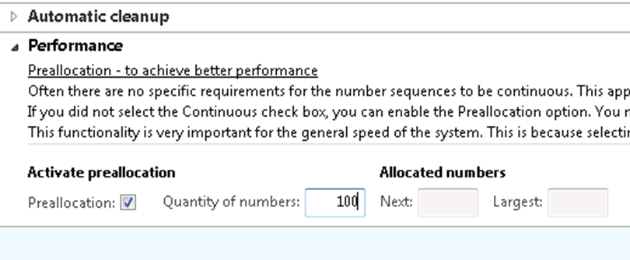
Number Sequence Pre-allocation
Setup
Organization Administration > Common > Number Sequences
Select a record > Performance
How it works
Continuous check box must be clear
Blocks of numbers are cached at the AOS to reduce DB calls
Cache scope is per user session
Gaps in sequence may occur
Notes:
If continuous numbers are not a requirement, then you can set the system up so that each AOS takes a “block” of numbers and issues them. For processes with a high transaction volume, this increases performance because the system no longer requests one from the database each time, but instead works within that block until used up.
Important: It is also important to note that the “block” of numbers that are provided is per user session, so numbers can be used up quite quickly. For example, if the pre-allocation amount is set to 50 when user 1 comes in, they grab a block of 50 to hold in memory; and when user 2 comes in, they grab another set of 50 to hold in memory.

Slide 20
Manage Number Sequences
Scenario: You see that sales order volume in company CEU is quite high. You want to optimize number sequences by setting up a pre-allocation amount.
Procedure: Organization Administration > Common > Number Sequences
Notes:
In this procedure, you will define a pre-allocation amount of 50 to the number sequences that are used for Sales orders.
Organization administration > Common > Number Sequences.
Double-click the AR_018 number sequence for company CEU.
Under General, ensure the check box labeled Continuous is clear.
Under Performance, select the Preallocation check box.
In the Quantity of numbers field, enter 50. An AOS will only have to request a number from the database every 50th time it needs one.
Close the form.
Important: If the Continuous check box is clear, but no pre-allocation quantity is entered, it is the same thing as if the Continuous check box was enabled.

Slide 21
Manage User Sessions
View or disconnect user sessions
View logon history
Clean up user logs
Managing unresponsive client sessions

Slide 22
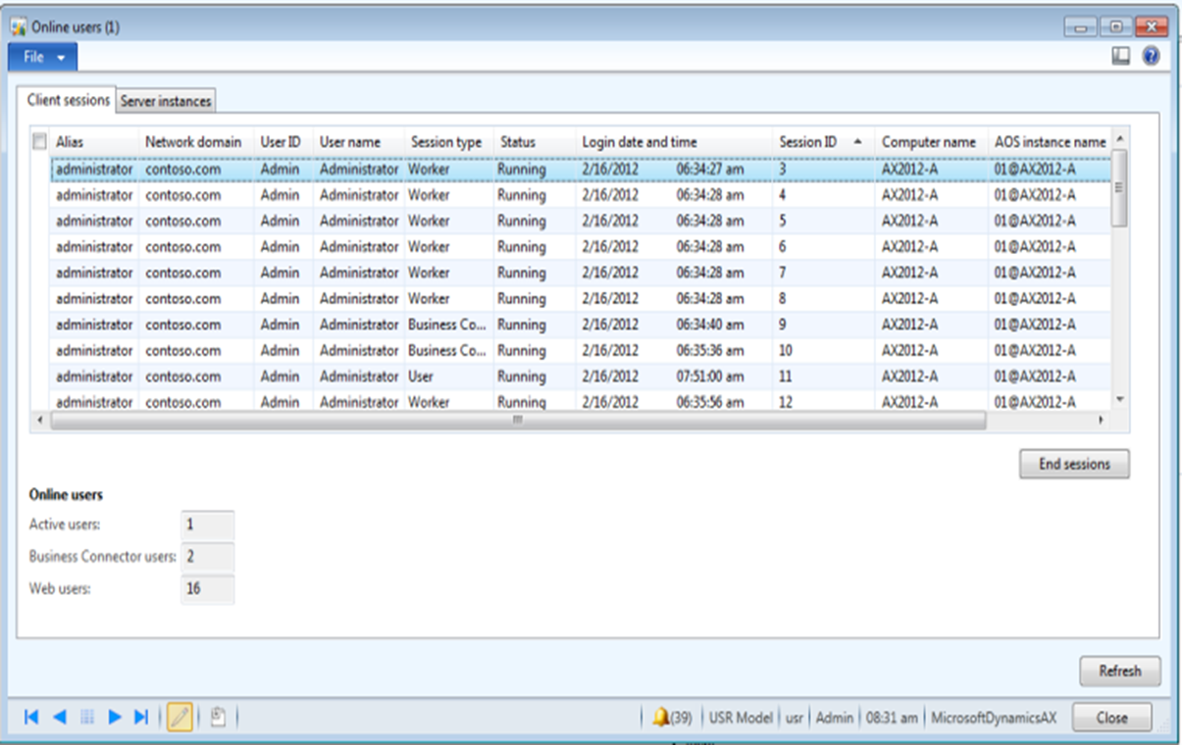
Online Users Form
System administration > Common > Users > Online users

Slide 23
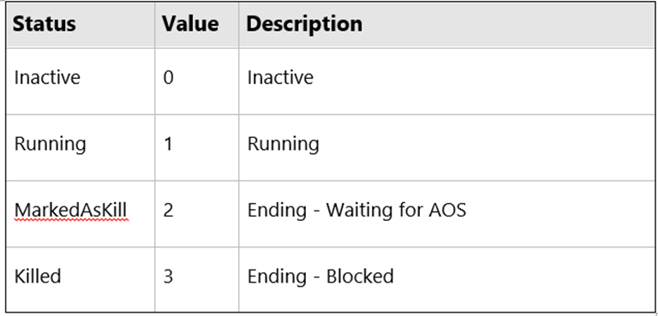
Online Users Form
User session status

Slide 24
Manage User Sessions
How to handle Unresponsive user sessions
End session through Online users form -OR-
Use Ctrl+Break from the client
Avoid using
Crtl+Alt+Delete
Task Manager > End Process
This may cause orphaned sessions and lead to blocking in the database or cause resource issues on the AOS

Slide 25
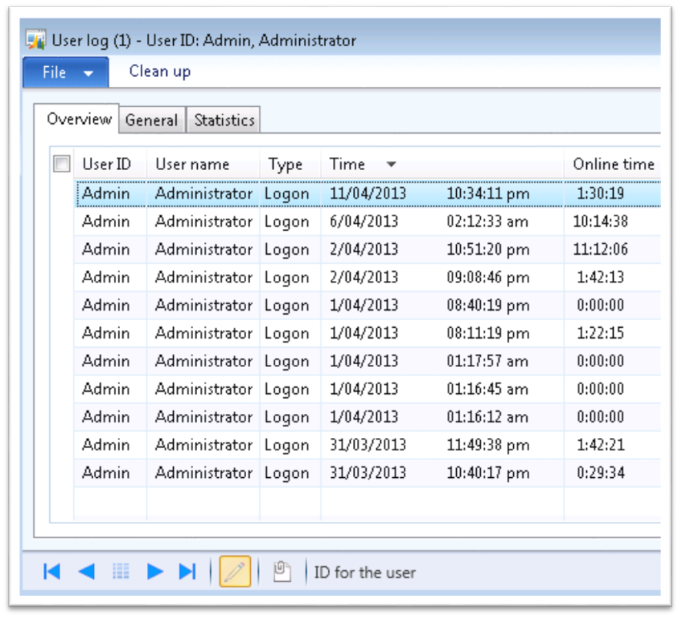
User Logon Statistics
System administration > Inquiries > Users > User log
View history
View statistics
Clean up log

Slide 26
Manage User Options
The User Options form allows Administrators the ability to set default information about a user such as:
Default company
Status bar
Application object layer display
Debug mode
Usage data

Slide 27
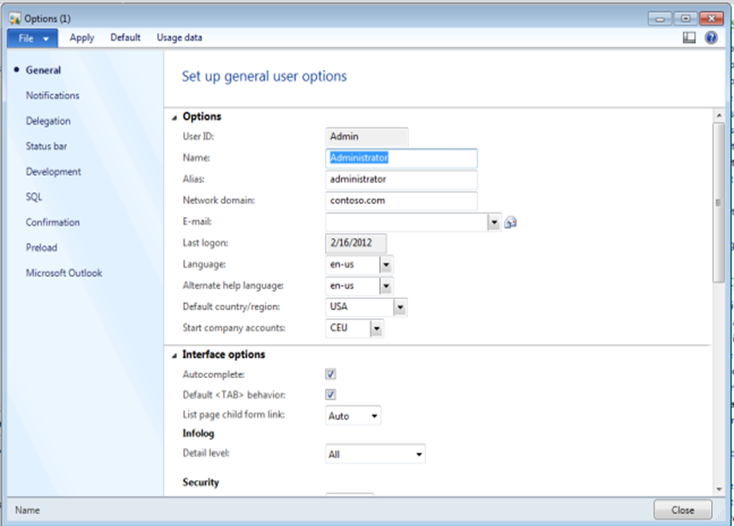
Manage User Options
File >Tools > Options
Notes:
The User Options form allows Administrators the ability to set default information about a user such as:
Default company
Status bar
Application object layer display
Debug mode
Usage data
Procedure: Change User Options
Gary, the Systems Administrator, wants to change his user options:
Open File>Tools>Options.
The screenshot on the slide above shows the User Options form.
Click the General link.
Set Start company accounts = CEU.
Click the Status bar link and select the following options:
Show clock
Show company accounts
Show user ID
Click the Development link.
Set Application object layer = Show all layers
Click Apply.

Slide 28
Manage Usage Data
Usage data is stored for each user and saves user selections such as:
Query ranges
Report selections
Jobs
Form selections
Usage data is saved in the SYSLASTVALUE table

Slide 29
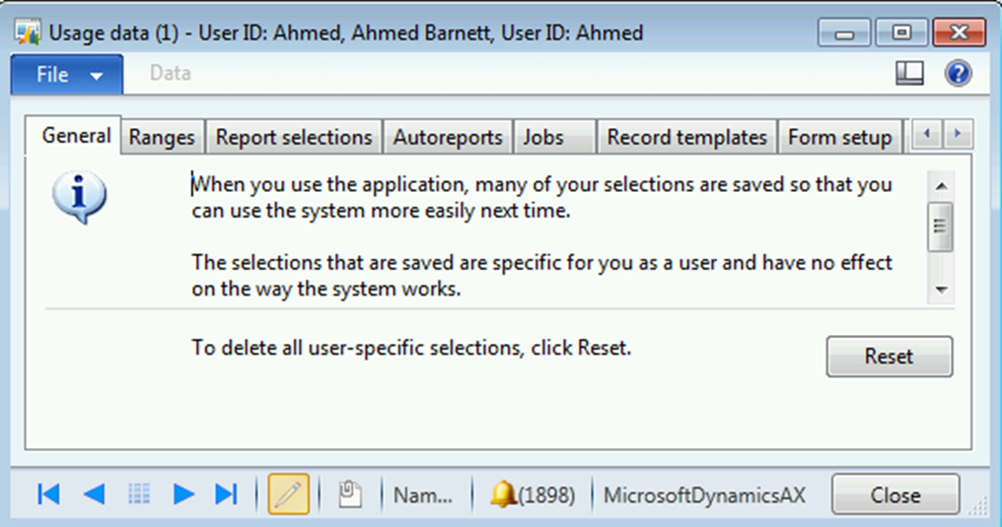
Manage Usage Data
Clear usage data
System administration > Common > Users
Select User and click Options
General tab > Reset
Notes:
Scenario: Clear Usage Data
You hear that Nancy is having issues printing a report. You suspect it is corrupt usage data, so you want to clear usage data for Nancy and no other users.
Procedure: Clear Usage Data
Open System administration > Common > Users.
Select Nancy and click Edit.
Select Options.
Click the Usage data button.

Slide 30
Data Compression
Data compression was introduced with SQL Server 2008.
SQL Server 2008 Enterprise edition feature
Selectively compress individual indexes to minimize storage requirements
Microsoft Dynamics AX 2012 supports this SQL Server feature

Slide 31
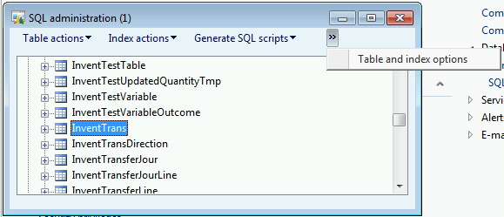
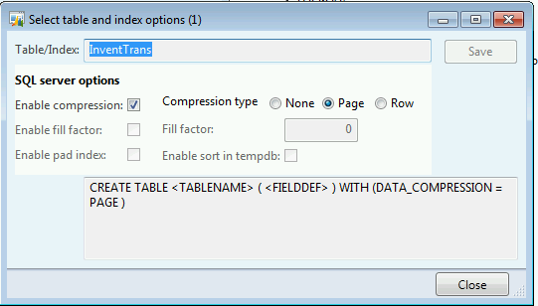
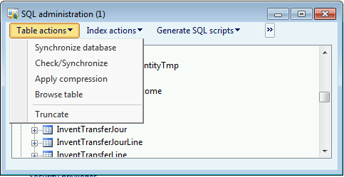
Data Compression
System administration > Periodic > Database > SQL administration
Select InventTrans table
Select Table and index options from the menu
Enable compression and select compression type
Select Apply compression from the Table actions menu

Slide 32
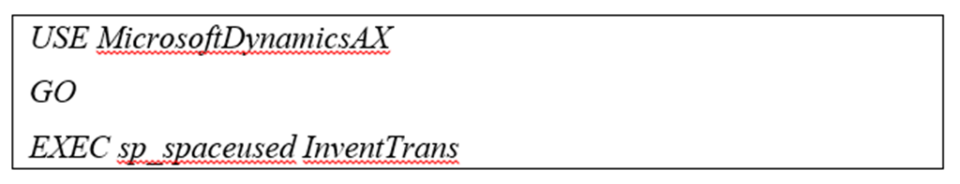
Compress InventTrans
Scenario: You see the InventTrans table is quite large and would like to compress it to decrease the size of the database and possibly improve performance
Procedure:
SQL Server Management Studio > New Query
System administration > Periodic > Database > SQL administration
Notes:
To configure the index to use data compression, follow these steps:
To check the size of the InventTrans table, open SQL Server Management Studio > New Query.
Type the following command and press F5 to execute:
USE MicrosoftDynamicsAX
GO
EXEC sp_spaceused InventTrans
Note the value for data in KB.
In the Table Properties form, click Storage and verify that the Compression type is set to page.
In the Microsoft Dynamics AX client, click System administration > Periodic > Database > SQL administration.
In the SQL administration form, expand All tables and find InventTrans.
With InventTrans highlighted, click Table and Index options.
In the Select table and index options form,
Select enable compression
Select the Compression type of page
Click Close
In the SQL Administration form, click the Table actions drop-down, and then click Apply compression.
To verify the change, open SQL Server Management Studio and open Object Explorer. Expand Databases > MicrosoftDynamicsAX > Tables > dbo.InventTrans.
Right-click dbo.InventTrans and select Properties.
In the Table Properties form, click Storage and verify that the Compression type is set to page.
To check the size of the InventTrans table after page compression was applied, open SQL Server Management Studio > New Query.
Type the following command and press F5 to execute:
USE MicrosoftDynamicsAX
GO
EXEC sp_spaceused InventTrans
Note the difference in KB for data before and after compression.

Slide 33
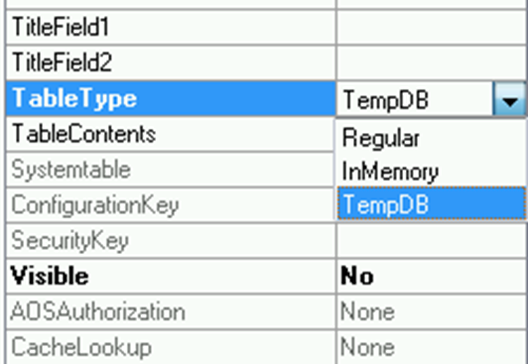
Table Types
Three different types of tables are available in the AOT.
Regular - this is a normal table stored in the Microsoft Dynamics AX database.
InMemory - Temporary table stored in memory.
TempDB - Temporary table created in the TempDB database on SQL Server. TempDB temporary tables can be joined on the database tier with regular tables.

Slide 34
Table Cache Configuration
Setting determines how to cache the records retrieved during a lookup operation.
Property is found in the AOT.
Important for administrators to understand this property as it can have performance implications.
Set-based cache
EntireTable
Record Cache
NotInTTS
Found
FoundAndEmpty
None
Notes:
On every Microsoft Dynamics AX table is a CacheLookup setting. This setting determines how to cache the records retrieved during a lookup operation. This property is found in the AOT. Although set by a developer, it is important for administrators to understand this property as it can have performance implications.
EntireTable - All the records in the table are placed in the cache after the first select. This type of caching follows the rules of single record caching in which the SELECT statement WHERE clause fields must match those of a unique index defined for the table. An EntireTable cache is flushed whenever an insert, update, or delete is made to the table. At the same time, the AOS notifies other AOS’s that their caches of the same table must be flushed. After the cache is flushed, a subsequent select on the table causes the entire table to be cached again. Regardless of when updates are made, EntireTable caches are flushed every 24 hours by the AOS.
NotInTTS – Requires data to be selected by a unique index to be cached. Subsequent selects that happen outside of a transaction block refer to cache. Selects within a transaction block always require a database call.
Found – Requires data to be selected by a unique index to be cached. Subsequent selects refer to cache.
Found and Empty – same as Found, but caches empty result sets too.
Best Practice: Avoid using EntireTableCache on tables larger than the value you have set for the EntireTable cache size at System administration > Setup > Server configuration > Performance optimization. When large tables are cached, the AOS is forced to write them to disk instead of keeping them in memory. Because of this limitation it’s better to use a different kind of cache for tables that meet this condition.
Best Practice: Avoid caching any table that's frequently updated..

Slide 35
Full-text Search
Microsoft Dynamics AX 2012 provides full-text search functionality that activates Microsoft Dynamics AX to search business data over a large volume of text data or documents. You can create a full-text index on tables of type Main and Group.
Like regular SQL Server indexes, full-text indexes can be automatically updated at the same time as data is modified in the associated tables. This is the default behavior for Microsoft Dynamics AX 2012.
Notes:
Microsoft Dynamics AX 2012 provides full-text search functionality that activates Microsoft Dynamics AX to search business data over a large volume of text data or documents. You can create a full-text index on tables of type Main and Group.
Like regular SQL Server indexes, full-text indexes can be automatically updated at the same time as data is modified in the associated tables. This is the default behavior for Microsoft Dynamics AX 2012.
In the Application Object Tree (AOT), developers can set the ChangeTracking property of a full-text index to either Auto or Manual. Indexes with the Auto property are updated automatically by SQL Server as data is modified in associated tables. You must manually update indexes with the Manual property at a specified interval.
The ChangeTracking property defaults to Auto for a new full-text index. Use the ChangeTracking property for optimal response time and throughput for the Microsoft Dynamics AX application.
Note: You must configure the SQL Server full-text search functionality before you use it in the Microsoft Dynamics AX application.

Slide 36
Test Your Knowledge
The class will complete this section

Slide 37
Chapter Review
Which of the following is not one of the system service accounts?
( ) Business Connector Proxy Account
( ) Workflow Execution Account
( ) Batch Processing Execution Account
( ) Bing Maps Account
True or False? By entering license codes, the administrator can enable or disable subsets of functionality within a specific module or feature of Microsoft Dynamics AX.
( ) True
( ) False
True or False? Entering a pre-allocation quantity on your number sequences can help increase performance for number sequences assigned to high-volume transactions.
( ) True
( ) False

Slide 38
Chapter Review (Answers)
Which of the following is not one of the system service accounts?
( ) Business Connector Proxy Account
( ) Workflow Execution Account
(x) Batch Processing Execution Account
( ) Bing Maps Account
True or False? By entering license codes, the administrator can enable or disable subsets of functionality within a specific module or feature of Microsoft Dynamics AX.
(x) True
( ) False
True or False? Entering a pre-allocation quantity on your number sequences can help increase performance for number sequences assigned to high-volume transactions.
(x) True
( ) False

Slide 39
Chapter Summary
In this chapter we discussed:
General system setup and parameters
Number sequence options
Managing user sessions and options
Table and index options

